Slide 1
OCTOTOOL
Group Members:
Michael Jia
Matthew Chen
Aaron Luo

Slide 2
Project
Develop a tool box that follows the user. This will primarily hold tools that a person needs to use or has. Kind of like a sentient robot toolbox that can provide tools on command. It will be able to park back into a slot when you turn it off or check out from work lets say. Basically an automated library but for tools.
Motivation:
We believe this will be useful for student teams and also technicians in industry where the use of tools are important and keeping it organized or accessible is requirement. This will save a lot of time usually wasted; looking for the toolkit and the right tool inside, increasing the overall working efficiency.

Slide 3
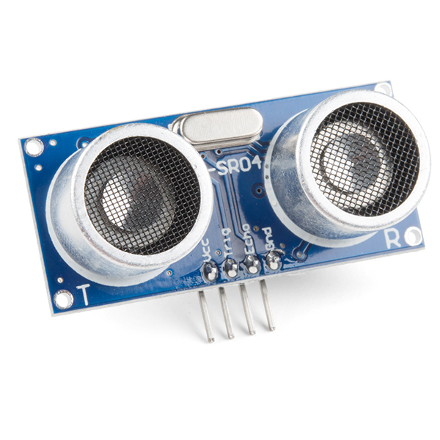
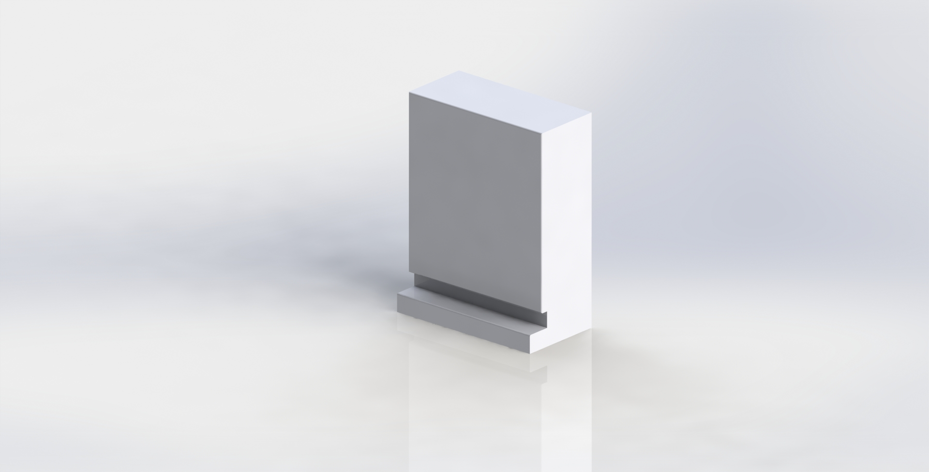
Microcontroller:
PSOC 6
Real time component:
The Toolkit will move forward, back, left, and right
Have real time obstacle detection using ultrasonic sensors
Multitasking elements:
The toolkit will follow the user
Have obstacle detection
GUI:
Communicates with the PSOC
Displays the direction the toolkit is moving, as well as when there is an obstacle being detected
Able to toggle the motors on and off
Ultrasonic sensor
Toolkit

